Slide 1
Console
Control signals
Audio output
CPU
Control Bus
SPU
Speakers
BIOS
Cartridge
Audio ROM
(sounds)
Cartridge controller
Audio ROM
(sounds)

Slide 2
SPU
Command request
Sound channels
CPU
SPU control
Mixer
Read samples
Store
Audio output
Audio ROMs
Output buffers
Speakers

Slide 3
-1
0
1
2
3
...
selected sound

Slide 4
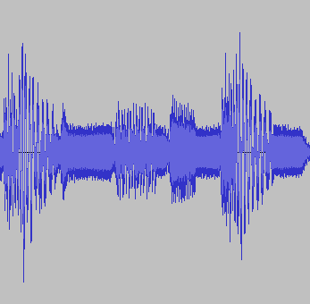
Unmodified
Volume = 1.8
Unmodified
Speed = 2.0

Slide 5
start position
end position
Initially
While loop remains enabled
If loop gets disabled

Slide 6
Position before jump
Jump target position
Skipped
Played
before jump
Played
after jump

Slide 7
Generating 1 output sample
Sound Channel
Produced
sample
Picked sample
×
Channel volume
Mixer
Channel’s playback position
×
Audio output
+
Output buffers
Speakers
Channel’s assigned Sound
Global volume
Final output
sample
×
Position = 0
Position = Length - 1
(Produced samples from
other playing channels)

Slide 8
Buffer ring to store and serve output samples
Mixer
To be played
Mixing
WRITES samples
Speakers
READ samples
Sound channels
Mixing logic
Being mixed
Buffer Ring
Being played
Speakers
To be mixed

